Slide 1
Concepts of Engineering Thermodynamics
Balkrishna Mehta
Department of Mechanical Engineering
Indian Institute of Technology Bhilai
krishnab@iitbhilai.ac.in
TEQIP-III
Faculty Development Program
on
Foundations on Thermal and Fluids Engineering
FTFE’19
Department of Mechanical Engineering
Indian Institute of Technology Bhilai
September 17-21, 2019

Slide 2
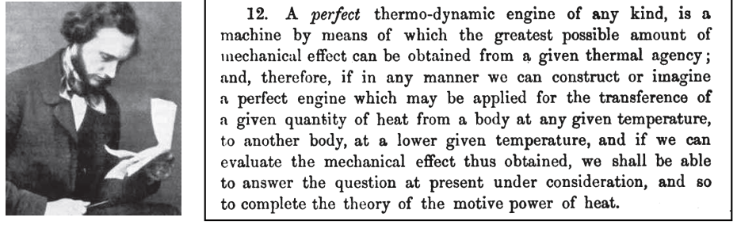
What is Thermo-dynamics?
Thermo (therme heat): Dynamics (dynamis power), first used by Thomson (Lord Kelvin) in 1849
It is a science of energy and entropy
Science which deals with heat and work and those properties of matter that relate with heat and work

Slide 3
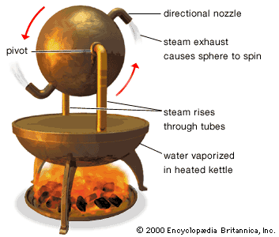
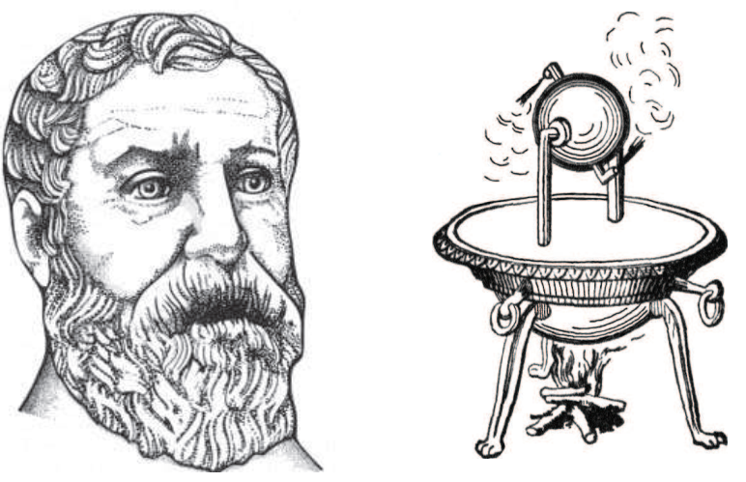
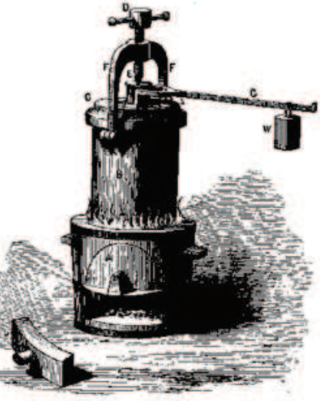
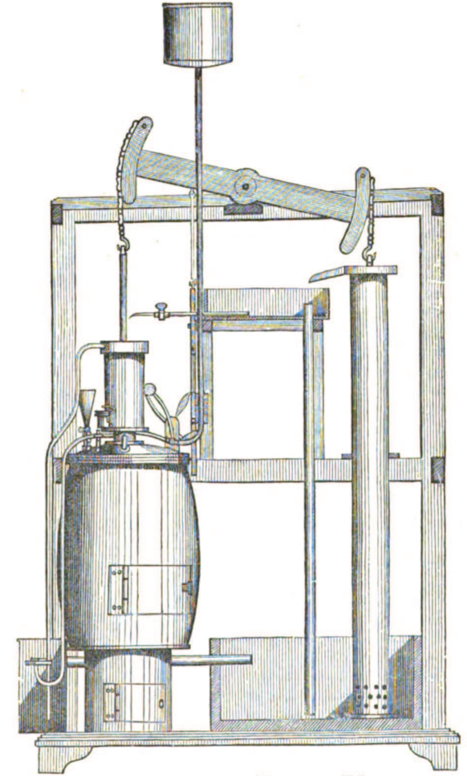
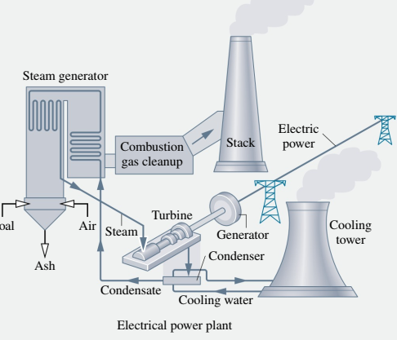
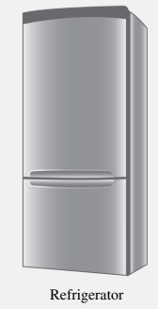
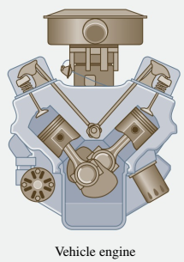
Ancient Demonstration of Heat Engine
Hero of Alexandria (10 AD - 70 AD)
Steam digester ( Papin, 1647-1712)
Steam engine (J. Watt, 1736-1819)
Modern demonstrations of various thermal systems

Slide 4
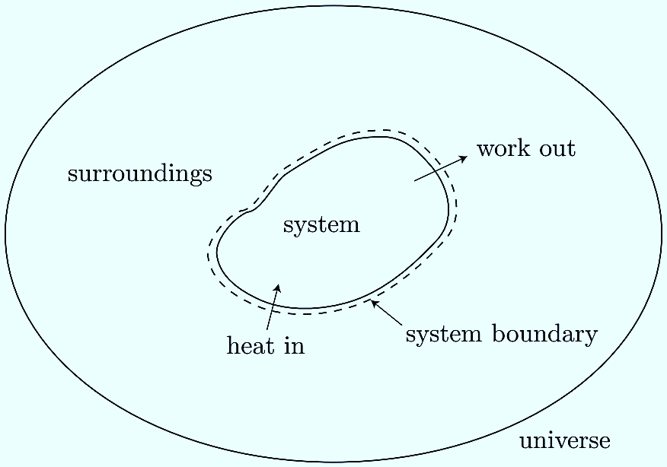
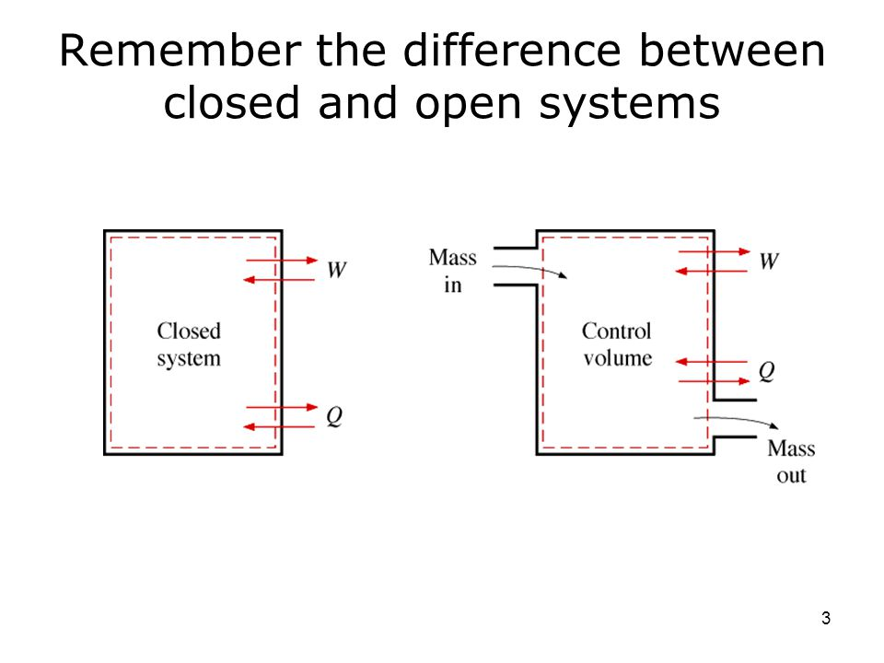
Concepts and Definitions
Thermodynamic system
A quantity of matter (fixed mass) or fixed/movable/deformable region under investigation
Surrounding
Everything external to the system is surrounding
System boundary
Interface separating system and surrounding
Universe
Combination of system and surrounding
W
Types of system
(a) Control mass system/closed system (b) Control volume system/ open system (c) Isolated system
W
Isolated
System
at
30°C
Q
Q
Isolated
system
m
Modes of interaction between system and surrounding
(a) Heat (Q) (b) Work (W) (c) Mass (m)
m
Surrounding at 30°C
Is this system
Isolated??

Slide 5
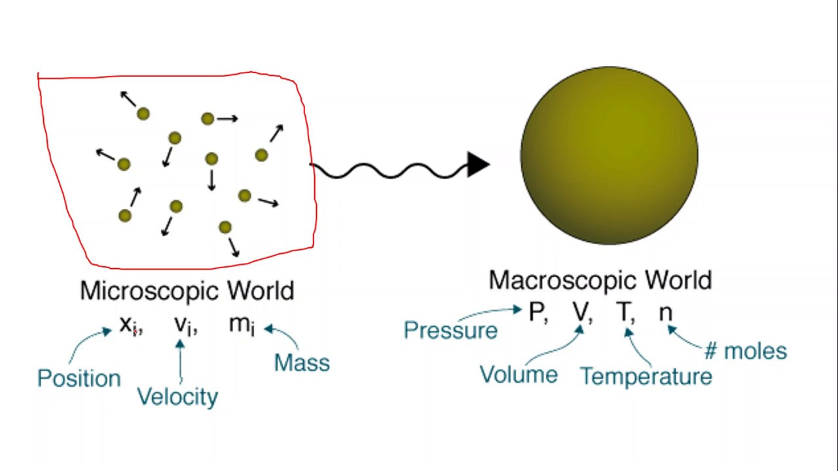
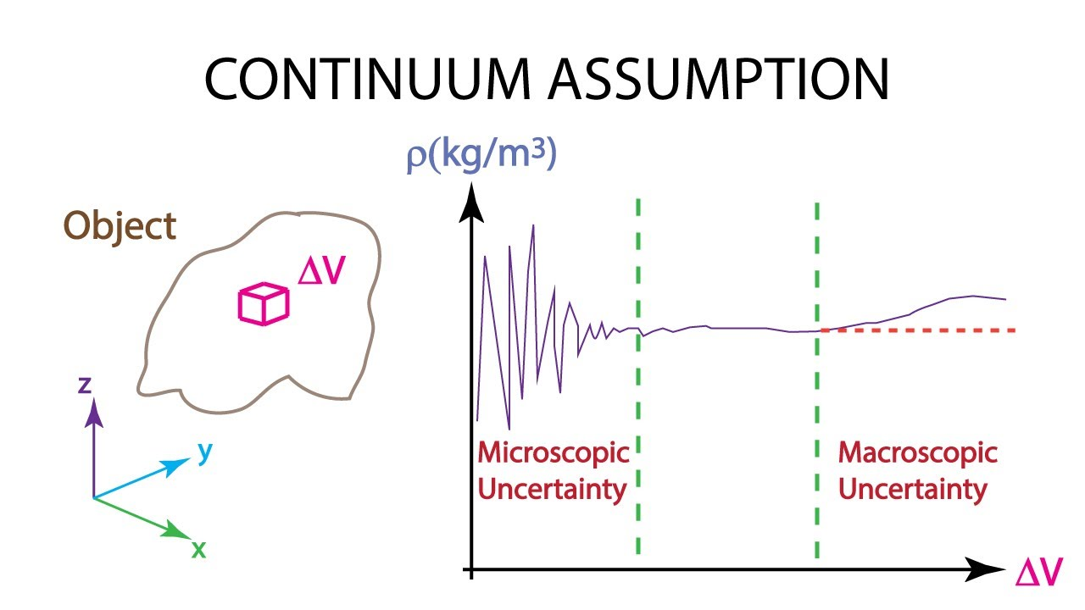
Microscopic and Macroscopic Perspective
Microscopic/Statistical Thermodynamics | Macroscopic/Classical Thermodynamics
Focusses on individual behavior of atom/molecules | Focusses on bulk behavior of substance constituted by collection of molecules/atoms
Discrete distribution of matter | Distribution of matter is continuous (Continuum)
Include energies from various motions like translation, rotation and vibration and configurational energies: atomic/nuclear and molecular bond | Bulk effect of the microscopic energy is felt as temperature of the matter
Interaction changes the total energy as a result of change in K.E. of atoms/molecules | Can be observed as Heat (Q) and Work (W) interaction

Slide 6
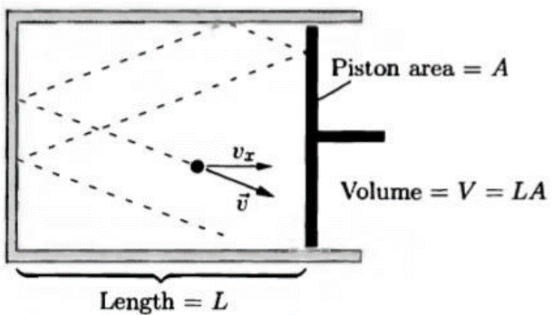
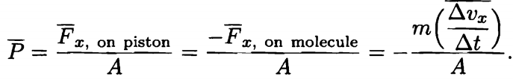
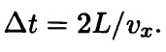
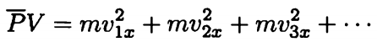
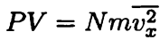
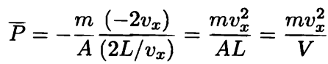
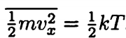
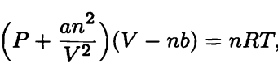
Origin of Temperature and Pressure (Microscopic view)
Temperature
Quantity which is same for two objects when they are in contact (thermal) for long time; time required to achieve thermal equilibrium is called relaxation time
Ideal gas law, PV = nRT; No. of molecules N = nxN_{A}; N_{A} is Avogadro number; PV = NkT; nR = Nk
For N molecules

Slide 7
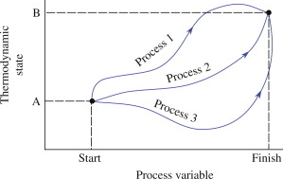
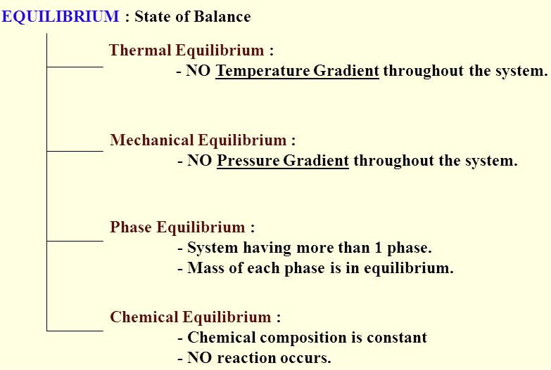
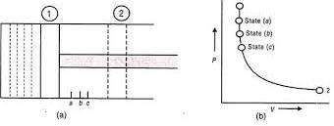
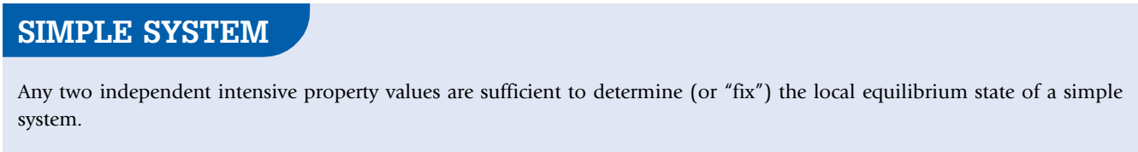
Properties, State and Process
Thermodynamic Properties
Macroscopic characteristics of a system like mass, energy, pressure, temperature and volume/density etc.
Extensive Properties: depends on extent of the matter (mass) like Total energy, mass and volume etc.
Intensive properties: intrinsic/inherent nature of matter, i.e., independent of quantity of matter/mass like Pressure (P), Temperature (T) and density (ρ)
Thermodynamic State
Condition of a system as described by its macroscopic properties; independent of history of system
Thermodynamic Process
Successive transformation from one state to other state
Thermodynamic Equilibrium
(a) Thermal equilibrium (b) Mechanical equilibrium (c) Chemical equilibrium
dT = 0
dP = 0
dμ = 0

Slide 8
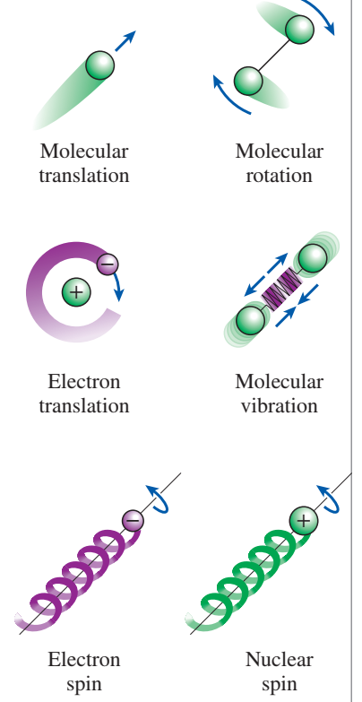
Energy and Energy in Transfer (Heat and Work)
E = U + ½mv² + mgz + ……(electric, magnetic…..)
Total Energy Internal Energy KE PE
Microscopic origin part of it is associated with KE of molecules known as Sensible energy
Part of it is associated with binding forces such as molecular and atomic bond
Latent Energy
Macroscopic origin
Total Energy is contained/stored in a system
Energy interaction / Energy in transit
For a system, Heat (Q), work (W) and mass (m)
Heat (Q): driving potential is temperature difference
Work (W): if the interaction is not heat then its work

Slide 9
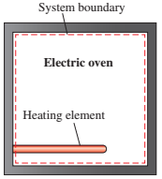
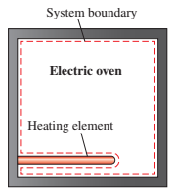
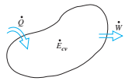
Understanding the Interactions through Heat and Work
Some Comments
Energy interaction through Q and W is recognized at system boundary
It is difficult to recognize the change of state of system through Q or W, after completion of the process
Both of these quantities are not a property of the system
Work (W)
Heat (Q)
W?
or
Q?
When heating element is included within the system boundary
When heating element is excluded from the system boundary
Sign Convention for Heat and Work

Slide 10
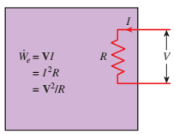
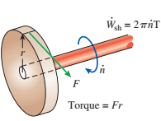
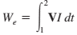
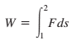
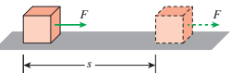
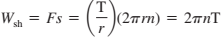
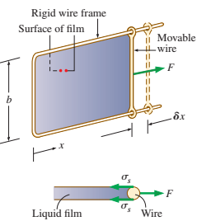
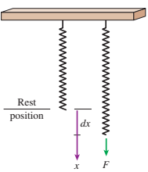
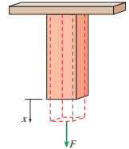
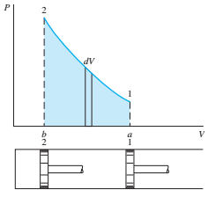
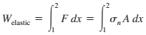
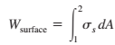
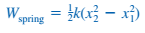
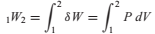
Different Form of Work

Slide 11
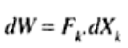
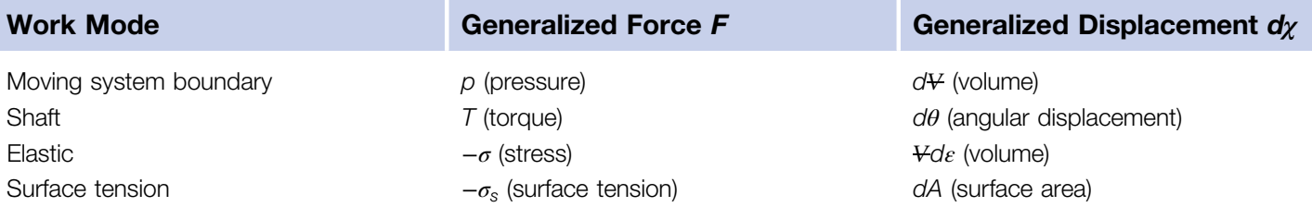
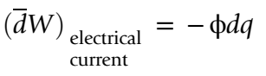
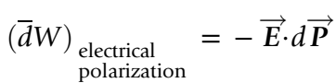
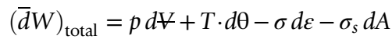
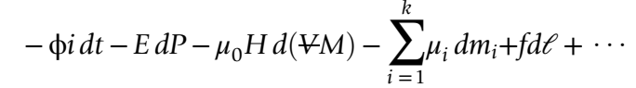
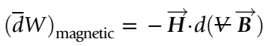
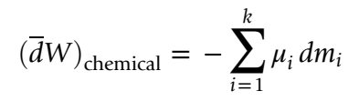

Slide 12


Work and Heat as Path Function (Non-property quantity)
Work in the given situation is actually area under P-V curve
Changes from state 1 to 2 or vice-versa are possible through various paths, e.g., path A, path B and path C
It can easily be observed that area under curves A, B and C are different for same end states
Therefore, it can be concluded that the work is dependent on the path as well as on the end states
Hence, work can not be a property of any system
Energy Balance

Slide 13


Foundation of First Law of Thermodynamics
Joule’s Experiment
In cyclic process: ∑Q = ∑W
W₁₋₂
Q₂₋₁
Gas expands when valve is opened
There is no Work transfer: W=0
As expansion is very fast; T remains constant, i.e., no Heat Transfer, Q = 0
Total energy remains constant; also, independent of volume
In process 1-2, fluid is heated by lowering the weight; Work input during 1-2
In the process 2-1 the heated system is kept in the pool of water to cool the system. Heat gained by water is calculated
It was observed: Q₂₋₁ = Change in PE of weight = W₁₋₂

Slide 14






First Law of Thermodynamics for Closed System
dE = δQ – δW
dU + d(KE) + d(PE) = δQ – δW
dU = δQ – δW ; for negligible KE and PE, where U is internal energy (property) of the system
dE /dt= δQ/ δt– δW/δt; for unsteady process
Enthalpy (Another Property)
H = U + PV
The U term can be interpreted as the energy required to create the system
the PV term as the work that would be required to "make room" for the system

Slide 15

Four processes are shown in the following figure. Each process occurs in a well-insulated piston cylinder assembly and starts from the same initial state, state 1. Put the final temperatures in order from highest to lowest. Explain. In Process A, a large block of mass, M, is removed from the piston. In Process B, an equivalent mass, M, is removed in incremental amounts. In Process C, a large block of mass, M, is placed on the piston. In Process D, an equivalent mass, M, is added in incremental amounts.

Slide 16







Properties of Pure Substances
Pure Substance
Substances that has homogeneous and invariable chemical composition; It can exist in one or more than one phases but with fixed chemical composition, e.g., ice-liquid water, liquid water-steam
Phase Boundary
Interfacial line/surface where both the phases has same properties and coexist
Isobaric Heat addition
Gibb’s Phase Rule: f = C - P + 2; number of intensive property to define a state of the system

Slide 17





Property Diagrams
T-v diagram for water
P-T-v surface which contracts on freezing
P-T-v surface which expands on freezing

Slide 18

More on P-T-v Diagrams and Surfaces

Slide 19


More on P-T-v Diagrams and Surfaces

Slide 20



Phase Transformation Diagrams

Slide 21




Phase Transformation Diagrams

Slide 22






Energy Analysis for Open Systems/Flow Process
Rate of mass balance/Conservation of mass

Slide 23






Flow Work and Energy of Flowing Fluid
Flow work
As mass crosses the boundary/control surface in open system, it requires
energy to push the mass into control volume (CV)

Slide 24



Energy Balance of Flowing Fluid through CV
Differential form
of Equation
Integral form
of Equation
Steady state form
of Energy Equation

Slide 25



Some Examples of Flow Process
Nozzle and Diffuser

Slide 26






Some Examples of Flow Process
Turbine and Compressor

Slide 27





Some Examples of Flow Process
Throttling Valves

Slide 28











Sample Example (Using the Laws of Thermodynamics)

Slide 29

Water at 25ºC is heated in a container with the valve fully open to the atmosphere. After the water has boiled sufficiently so that the space above is filled completely with the vapor, the valve is closed. The heating is continued till the temperature becomes the critical temperature. Now the system is cooled back to 25ºC. Draw this process on a T-v diagram. After a long time, if the valve is opened then, will the atmospheric air rush in or water vapor come out?

Slide 30
?? Thank You

Slide 31
Second Law, Entropy and Exergy Analysis
Balkrishna Mehta
Department of Mechanical Engineering
Indian Institute of Technology Bhilai
TEQIP-III
Faculty Development Program
on
Foundations on Thermal and Fluids Engineering
FTFE’19
Department of Mechanical Engineering
Indian Institute of Technology Bhilai
September 17-21, 2019

Slide 32




Motivation/Need of Second Law of Thermodynamics
What do we know till now??
Energy is a conserved quantity. Change in total energy (ΔE) is equal to the net energy interaction taking place at the boundary
Mechanism of energy interaction in terms of either work (W) or heat (Q)
Temperature (T; not exactly known) is outcome of kinetic energy of the particles as molecular level
What is not known till now??
Why does heat spontaneously flow from hotter object to cooler object, not other way, even when energy conservation holds?
Why just providing heat to pedal or electrical wire does not lead to lifting of weight or flow of current in wire?

Slide 33

Motivation/Need of Second Law of Thermodynamics
It predicts the direction in time of processes.
It aids in determining equilibrium conditions.
It allows one to determine peak performance of practical devices.
It enables one to frame analysis of the factors which inhibit the realization of peak performance.
It allows a rational definition of the absolute temperature scale.
It has implications beyond engineering in physics, philosophy, economics, computer science, etc.
Some terms/words to familiarize with
Thermal energy reservoir
Bodies of relatively large thermal masses which can supply or store the energy without changing its temperature
Source
Body which supplies any amount of energy without change in its temperature
Sink
Body which receives any amount of energy without change in its temperature

Slide 34






Qualitative comparison of Heat and Work
It is simple to observe that work can be converted into the heat directly and completely but reverse is not true.
Heat Engines
The device which converts heat in to work is called heat engines
They receive heat from a high-temperature source (solar energy, oil furnace, nuclear reactor, etc.).
They convert part of this heat to work (usually in the form of a rotating shaft).
They reject the remaining waste heat to a low-temperature sink (the atmosphere, rivers, etc.).
They operate on a cycle.
Ƞ_{th} < 100%

Slide 35



Statements of Second Law of Thermodynamics
Clausius Statement
“Heat cannot, of itself, pass from a colder to a hotter body”
Kelvin-Planck
It is impossible for any system to operate in a thermodynamic cycle and deliver a net amount of work to its surroundings while receiving an energy transfer by heat from a single thermal reservoir
Carathéodory
In the neighborhood of any equilibrium state of a thermodynamic system, there are equilibrium states that are adiabatically inaccessible

Slide 36



Traditional
definition
Ideal and Actual Processes (Second Law Restriction)
As no machine can achieve 100% efficiency, then, what is maximum efficiency and how??
Reversible process: A process in which it is possible to return both the system and surroundings to their original states
Irreversible process: A process in which it is impossible to return both the system and surroundings to their original states
All the processes occurring in nature are irreversible.
Why are we interested in reversible processes?
(1) they are easy to analyze and (2) they serve as idealized models (theoretical limits) to which actual processes can be compared.
Some processes are more irreversible than others.
We try to approximate reversible processes. Why?
Two familiar reversible processes
Reversible processes deliver the most and consume the least work.

Slide 37



Factors Leading to Irreversibility
The factors that cause a process to be irreversible are called irreversibilities.
They include friction, unrestrained expansion, mixing of two fluids, heat transfer across a finite temperature difference, electric resistance, inelastic deformation of solids, and chemical reactions.
The presence of any of these effects renders a process irreversible.
Friction renders a process irreversible.
Irreversible compression and expansion processes.
(a) Heat transfer through a temperature difference is irreversible, and (b) the reverse process is impossible.

Slide 38



Internal and External Reversible Processes
Internally reversible process: If no irreversibilities occur within the boundaries of the system during the process.
Externally reversible: If no irreversibilities occur outside the system boundaries.
Totally reversible process: It involves no irreversibilities within the system or its surroundings.
A totally reversible process involves no heat transfer through a finite temperature difference, no non-quasi-equilibrium changes, and no friction or other dissipative effects.
Totally and internally reversible heat transfer processes.
A reversible process involves no internal and external irreversibilities.

Slide 39


THE CARNOT CYCLE
Reversible Isothermal Expansion (process 1-2, T_{H} = constant)
Reversible Adiabatic Expansion (process 2-3, temperature drops from T_{H} to T_{L})
Reversible Isothermal Compression (process 3-4, T_{L} = constant)
Reversible Adiabatic Compression (process 4-1, temperature rises from T_{L} to T_{H})
Execution of the Carnot cycle in a closed system.

Slide 40


THE CARNOT CYCLE
P-V diagram of the Carnot cycle
P-V diagram of the reversed Carnot cycle.
The Reversed Carnot Cycle
The Carnot heat-engine cycle is a totally reversible cycle.
Therefore, all the processes that comprise it can be reversed, in which case it becomes the Carnot refrigeration cycle.

Slide 41


Carnot Principles
The efficiency of an irreversible heat engine is always less than the efficiency of a reversible one operating between the same two reservoirs.
The efficiencies of all reversible heat engines operating between the same two reservoirs are the same.
The Carnot principles.
Proof of the first Carnot principle.

Slide 42



The Absolute Thermodynamic Temperature Scale
A temperature scale that is independent of the properties of the substances that are used to measure temperature is called a thermodynamic temperature scale.
Such a temperature scale offers great conveniences in thermodynamic calculations.
$$η=1−\frac{QL}{QH}=1−\frac{TL}{TH}$$
$$\lim_{TL→0}{η=1}$$
$$\lim_{TH→∞}{η=1}$$
This temperature scale is called the Kelvin scale, and the temperatures on this scale are called absolute temperatures.
The arrangement of heat engines used to develop the thermodynamic temperature scale.

Slide 43



Some Implications of Carnot Heat Engine
The Carnot heat engine is the most efficient of all heat engines operating between the same high- and low-temperature reservoirs.
Carnot (Reversible) heat engine
Any heat engine
No heat engine can have a higher efficiency than a reversible heat engine operating between the same high- and low-temperature reservoirs.

Slide 44


Quantitative Assessment of Quality of Energy
Can we use °C unit for temperature here?
How do you increase the thermal efficiency of a Carnot heat engine?
How about for actual heat engines?
The higher the temperature of the thermal energy, the higher its quality.
The fraction of heat that can be converted to work as a function of source temperature.

Slide 45




Refrigerator and Heat Pump
Any refrigerator or heat pump
How do you increase the COP of a Carnot refrigerator or heat pump? How about for actual ones?
Carnot refrigerator or heat pump
No refrigerator can have a higher COP than a reversible refrigerator operating between the same temperature limits.

Slide 46




Entropy
Clasius inequality
Formal definition of entropy
The equality in the Clausius inequality holds for totally or just internally reversible cycles and the inequality for the irreversible ones.
The system considered in the development of the Clausius inequality.

Slide 47






Entropy: A Thermodynamic Property

Slide 48





Entropy of Pure Substances

Slide 49



Property Relations
First law: dU = δQ – δW
For a simple compressible system and quasi-static process
δQ =TdS; δW = PdV
then
In general
therefore,
TdS = dU + PdV
or
Tds = du + Pdv
Gibb’s Relations
using H = U + PV or h = u + Pv
TdS = dH - VdP
or
Tds = dh - vdP

Slide 50
Principle of Increase of Entropy
dS= (δQ _{rev}/T ) or S₂-S₁= ∫(δQ _{rev}/T )
S_{gen} ≥ 0
S_{gen} = 0; for reversible process
S_{gen} > 0; for irreversible process
S_{gen} < 0; for impossible process
with the help of 1st law, it can be shown
modern
definition
dS= (δQ _{act}/T ) + {δW_{rev} – δW_{act}}/T
Entropy
Transfer
Entropy
Generation, S_{gen}
Reversible process: the process in which no entropy generation occurs
Irreversible Process: the process in which the entropy generation is unavoidable
As W_{rev}>W_{act}, and T is absolute temperature, then it is clear that S_{gen} is always a positive quantity
What is the change of entropy of an isolated system?
Can entropy of a system during the process decrease??

Slide 51

Some Remarks about Entropy
Processes can occur in a certain direction only, not in any direction. A process must proceed in the direction that complies with the increase of entropy principle, that is, S_{gen} ≥ 0. A process that violates this principle is impossible.
Entropy is a nonconserved property, and there is no such thing as the conservation of entropy principle. Entropy is conserved during the idealized reversible processes only and increases during all actual processes.
The performance of engineering systems is degraded by the presence of irreversibilities, and entropy generation is a measure of the magnitudes of the irreversibilities during that process. It is also used to establish criteria for the performance of engineering devices.
The entropy change of a system can be negative, but the entropy generation cannot.

Slide 52
Entropy Balance
Entropy Change of a System, ∆S_{system}
When the properties of the system are not uniform
Energy and entropy balances for a system.

Slide 53



Mechanism of Entropy Transfer
Heat Transfer
Entropy transfer by heat transfer:
Heat transfer is always accompanied by entropy transfer in the amount of Q/T, where T is the boundary temperature.
Entropy transfer by work:
No entropy accompanies work as it crosses the system boundary.
But entropy may be generated within the system as work is dissipated into a less useful form of energy.

Slide 54

Mechanism of Entropy Transfer
Mass Flow
Entropy transfer by mass:
When the properties of the mass change during the process

Slide 55





Change in Entropy in Control Volume

Slide 56



Exergy Analysis
The useful work potential of a given amount of energy at some specified state is called exergy, which is also called the availability or available energy.
A system is said to be in the dead state when it is in thermodynamic equilibrium with the environment it is in.
A system’s available and unavailable energy. The potential energy of weight A has more “available” potential energy to do useful work relative to the ground than does weight B. However, the potential energy of weight C is negative relative to the ground and therefore is “unavailable” to do useful work relative to the ground.
A system that is in equilibrium with its environment is said to be at the dead state.
At the dead state, the useful work potential (exergy) of a system is zero.

Slide 57


Exergy Analysis
A system delivers the maximum possible work as it undergoes a reversible process from the specified initial state to the state of its environment, that is, the dead state.
This represents the useful work potential of the system at the specified state and is called exergy.
Exergy represents the upper limit on the amount of work a device can deliver without violating any thermodynamic laws.
The immediate surroundings of a hot potato are simply the temperature gradient zone of the air next to the potato.
The atmosphere contains a tremendous amount of energy, but no exergy.

Slide 58




Maximum Reversible Work
A system delivers the maximum possible work as it undergoes a reversible process from the specified initial state to the state of its environment, that is, the dead state.
Total max work or useful max work??

Slide 59





Maximum Useful Reversible Work
Total Availability

Slide 60




Exergy/Availability Balance for Closed System
A_{production} = 0 for reversible
A_{production} ≠ 0 for irreversible
Rate of Irreversibility = T_{o}S_{gen}
From the 1st Law
If a system is steady state, does that necessarily mean that dV/dt and dA/dt are both zero?
From the 2nd Law
dS= (δQ _{rev}/T ) or S₂-S₁= ∫(δQ /T ) + S_{gen}
A_{transfer} for work
Combining above three
A_{transfer} for heat
A_{destruction}

Slide 61






Exergy/Availability Balance and Efficiency for Open System

Slide 62






Thermodynamic Relations
Measurable Properties: Which can be experimentally measures like P, T and v etc.
Evaluated properties: Calculated by using some relations using the measurable quantities, u, h and s etc.
The Clapeyron Equation

Slide 63




Thermodynamic Relations
Volumetric expansivity
isothermal and adiabatic compressibility

Slide 64



Joule-Thompson Coefficient
The temperature behavior of a fluid during a throttling (h = constant) process is described by the Joule-Thomson coefficient
The Joule-Thomson coefficient represents the slope of h = constant lines on a T-P diagram.
The temperature of a fluid may increase, decrease, or remain constant during a throttling process.
The development of an h = constant line on a P-T diagram.

Slide 65

Joule-Thompson Coefficient
A throttling process proceeds along a constant-enthalpy line in the direction of decreasing pressure, that is, from right to left.
Therefore, the temperature of a fluid increases during a throttling process that takes place on the right-hand side of the inversion line.
However, the fluid temperature decreases during a throttling process that takes place on the left-hand side of the inversion line.
It is clear from this diagram that a cooling effect cannot be achieved by throttling unless the fluid is below its maximum inversion temperature.
This presents a problem for substances whose maximum inversion temperature is well below room temperature.
Constant-enthalpy lines of a substance on a T-P diagram.

Slide 66




Joule-Thompson Coefficient
The temperature of an ideal gas remains constant during a throttling process since h = constant and T = constant lines on a T-P diagram coincide.

Slide 67
?? Thank You

